Slide 1
Divide and Conquer

Slide 2
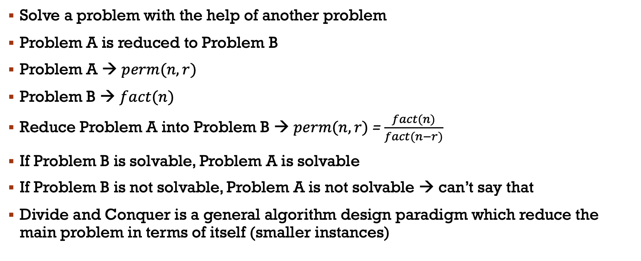
Reduction
Solve a problem with the help of another problem
Problem A is reduced to Problem B
Problem A → $perm(n, r)$
Problem B → $fact(n)$
Reduce Problem A into Problem B → $perm(n, r)$= $\frac{fact(n)}{fact(n−r)}$
If Problem B is solvable, Problem A is solvable
If Problem B is not solvable, Problem A is not solvable → can’t say that
Divide and Conquer is a general algorithm design paradigm which reduce the main problem in terms of itself (smaller instances)

Slide 3
Divide and conquer
Divide
Divide the problem into number of sub-problems that are smaller instances of the same problem
Conquer
Conquer the sub-problems by solving them recursively
Combine
Combine the solutions to the sub-problems into the solution for the original problem
The base case for the recursion are sub-problems of constant size
Analysis can be done using recurrence equations

Slide 4

Finding Maximum of an array
Input: an array $A[1..n]$of $n$ numbers
Output: the maximum number of $A$
1 2 3 4 5 6 7 8 9 10 11 12 13 14 15 16
A
13 | -13 | -25 | 20 | -3 | -16 | -23 | 18 | 20 | -7 | 12 | -5 | -22 | 15 | -4 | 7
List List 1 List 2
n elements n/2 elements n/2 elements
max max1 max2
max = MAX ( max1, max2 )

Slide 5

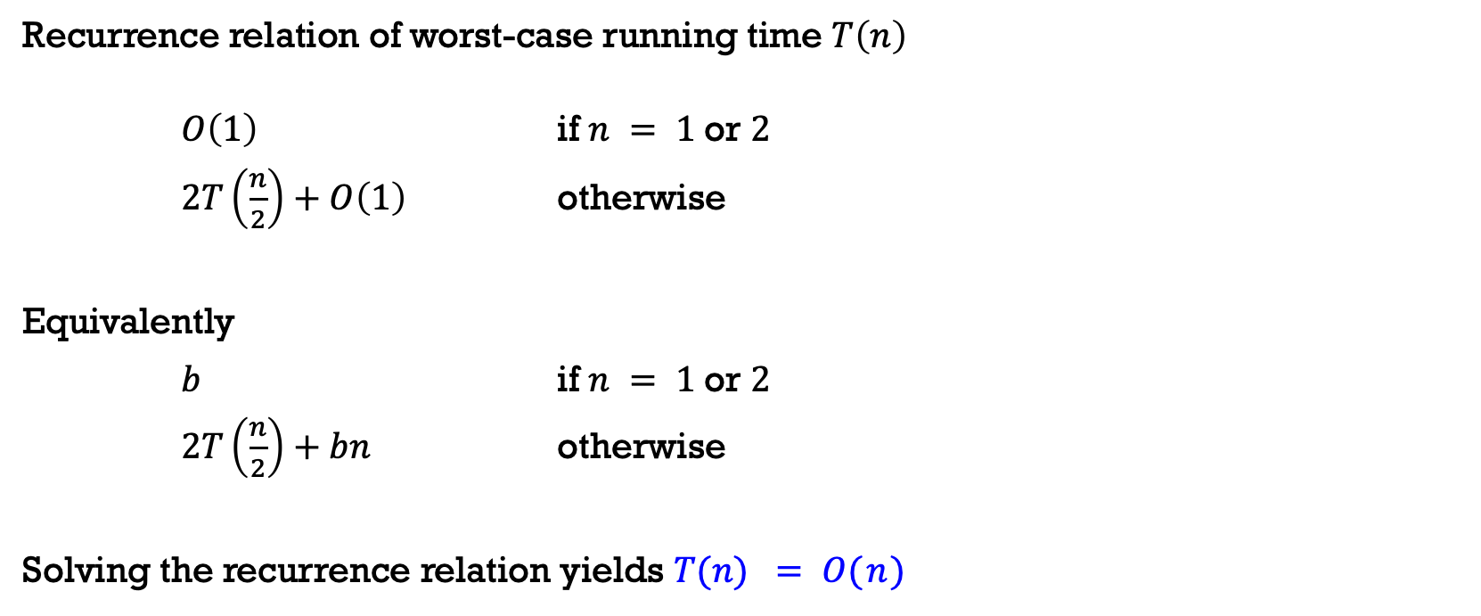

Finding Maximum of an array
Recurrence relation of worst-case running time $T\left(n\right)$
$O\left(1\right)$ if $n = 1$or $2$
$2T\left(\frac{n}{2}\right)+O\left(1\right)$ otherwise
Equivalently
$b$ if $n = 1$or $2$
$2T\left(\frac{n}{2}\right)+bn$ otherwise
Solving the recurrence relation yields $T(n) = O( n )$
$$T\left(n\right)=$$
$$T\left(n\right)=$$

Slide 6
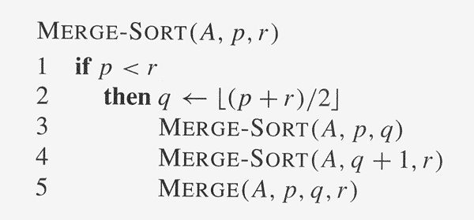
Merge sort algorithm
Divide step is trivial – just split the list into two equal parts
Work is carried out in the conquer step by merging two sorted lists
p |  |  |  | q | q+1 |  |  |  | r

Slide 7

Merge sort algorithm
7 2 9 4 3 8 6 1
7 → 7
2 → 2
9 → 9
4 → 4
3 → 3
8 → 8
6 → 6
1 → 1

Slide 8
Merge sort algorithm
Divide
7 2 9 4 3 8 6 1
7 2 9 4
7 → 7
2 → 2
9 → 9
4 → 4
3 → 3
8 → 8
6 → 6
1 → 1

Slide 9
Merge sort algorithm
Recursive call → Divide
7 2 9 4 3 8 6 1
7 2 9 4
7 2
7 → 7
2 → 2
9 → 9
4 → 4
3 → 3
8 → 8
6 → 6
1 → 1

Slide 10
Merge sort algorithm
Recursive call → Divide
7 2 9 4 3 8 6 1
7 2 9 4
7 2
7
2 → 2
9 → 9
4 → 4
3 → 3
8 → 8
6 → 6
1 → 1

Slide 11
Merge sort algorithm
Base Case
7 2 9 4 3 8 6 1
7 2 9 4
7 2
7→ 7
2 → 2
9 → 9
4 → 4
3 → 3
8 → 8
6 → 6
1 → 1

Slide 12
Merge sort algorithm
Recursive call → Divide
7 2 9 4 3 8 6 1
7 2 9 4
7 2
7→ 7
2
9 → 9
4 → 4
3 → 3
8 → 8
6 → 6
1 → 1

Slide 13
Merge sort algorithm
Base Case
7 2 9 4 3 8 6 1
7 2 9 4
7 2
7→ 7
2→ 2
9 → 9
4 → 4
3 → 3
8 → 8
6 → 6
1 → 1

Slide 14
Merge sort algorithm
Merge
7 2 9 4 3 8 6 1
7 2 9 4
7 2 → 2 7
7→ 7
2→ 2
9 → 9
4 → 4
3 → 3
8 → 8
6 → 6
1 → 1

Slide 15
Merge sort algorithm
…, Merge
7 2 9 4 3 8 6 1
7 2 9 4
7 2 → 2 7
9 4 → 4 9
7→ 7
2→ 2
9→ 9
4→ 4
3 → 3
8 → 8
6 → 6
1 → 1

Slide 16
Merge sort algorithm
Merge
7 2 9 4 3 8 6 1
7 2 9 4 → 2 4 7 9
7 2 → 2 7
9 4 → 4 9
7→ 7
2→ 2
9→ 9
4→ 4
3 → 3
8 → 8
6 → 6
1 → 1

Slide 17
Merge sort algorithm
Merge
7 2 9 4 3 8 6 1
7 2 9 4 → 2 4 7 9
3 8 6 1 → 1 3 6 8
7 2 → 2 7
9 4 → 4 9
3 8 → 3 8
6 1 → 1 6
7→ 7
2→ 2
9→ 9
4→ 4
3→ 3
8→ 8
6→ 6
1→ 1

Slide 18
Merge sort algorithm
Merge
7 2 9 4 3 8 6 1 → 1 2 3 4 6 7 8 9
7 2 9 4 → 2 4 7 9
3 8 6 1 → 1 3 6 8
7 2 → 2 7
9 4 → 4 9
3 8 → 3 8
6 1 → 1 6
7→ 7
2→ 2
9→ 9
4→ 4
3→ 3
8→ 8
6→ 6
1→ 1

Slide 19
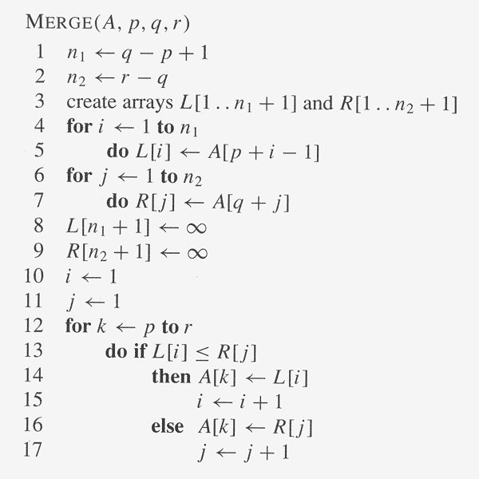
Merge sort algorithm
p |  |  |  | q | q+1 |  |  |  | r
1 |  |  |  | n₁+1
1 |  |  |  | n₂+1

Slide 20
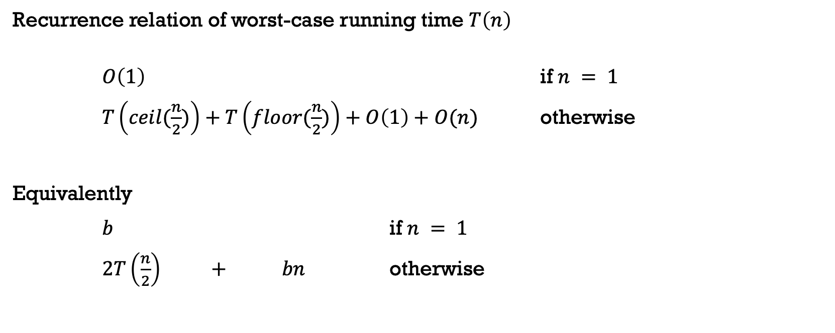

Merge Sort
Recurrence relation of worst-case running time $T\left(n\right)$
$O\left(1\right)$ if $n = 1$
$T\left(ceil(\frac{n}{2})\right)+T\left(floor(\frac{n}{2})\right)+O\left(1\right)+O(n)$ otherwise
Equivalently
$b$ if $n = 1$
$2T\left(\frac{n}{2}\right) + bn$ otherwise
$$T\left(n\right)=$$
solve left half
solve right half
dividing
merging
$$T\left(n\right)=$$
sorting both halves
Dividing + merging

Slide 21

Merge Sort
$T(n)$

Slide 22



Merge Sort
$bn$
$$T(\frac{n}{2})$$
$$T(\frac{n}{2})$$

Slide 23



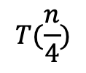
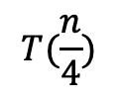

Merge Sort
$bn$
$$\frac{bn}{2}$$
$$\frac{bn}{2}$$
$$T(\frac{n}{4})$$
$$T(\frac{n}{4})$$
$$T(\frac{n}{4})$$
$$T(\frac{n}{4})$$

Slide 24









Merge Sort
$bn$
$$\frac{bn}{2}$$
$$\frac{bn}{2}$$
$$\frac{bn}{4}$$
$$\frac{bn}{4}$$
$$\frac{bn}{4}$$
$$\frac{bn}{4}$$
$$b$$
$$b$$
$$b$$
$$b$$
$$b$$
$$b$$
$$b$$

Slide 25




Merge Sort
$$bn$$
$bn$
$$\frac{bn}{2}$$
$$\frac{bn}{2}$$
$$bn$$
$$\frac{bn}{4}$$
$$\frac{bn}{4}$$
$$\frac{bn}{4}$$
$$\frac{bn}{4}$$
$$bn$$
$$b$$
$$b$$
$$b$$
$$b$$
$$b$$
$$b$$
$$b$$
$$bn$$

Slide 26

Merge Sort
$$bn$$
$bn$
$$\frac{bn}{2}$$
$$\frac{bn}{2}$$
$$bn$$
$$\log_{2}{n}$$
$$\frac{bn}{4}$$
$$\frac{bn}{4}$$
$$\frac{bn}{4}$$
$$\frac{bn}{4}$$
$$bn$$
$$b$$
$$b$$
$$b$$
$$b$$
$$b$$
$$b$$
$$b$$
$$bn$$

Slide 27

Merge Sort
$$bn$$
$bn$
In Total
$$bnlog_{2}n$$
$$\frac{bn}{2}$$
$$\frac{bn}{2}$$
$$bn$$
$$\log_{2}{n}$$
$$\frac{bn}{4}$$
$$\frac{bn}{4}$$
$$\frac{bn}{4}$$
$$\frac{bn}{4}$$
$$bn$$
$$b$$
$$b$$
$$b$$
$$b$$
$$b$$
$$b$$
$$b$$
$$bn$$

Slide 28
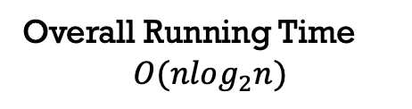
Merge Sort
$$bn$$
$bn$
Overall Running Time
$$O(nlog_{2}n)$$
$$\frac{bn}{2}$$
$$\frac{bn}{2}$$
$$bn$$
$$\log_{2}{n}$$
$$\frac{bn}{4}$$
$$\frac{bn}{4}$$
$$\frac{bn}{4}$$
$$\frac{bn}{4}$$
$$bn$$
$$b$$
$$b$$
$$b$$
$$b$$
$$b$$
$$b$$
$$b$$
$$bn$$

Slide 29
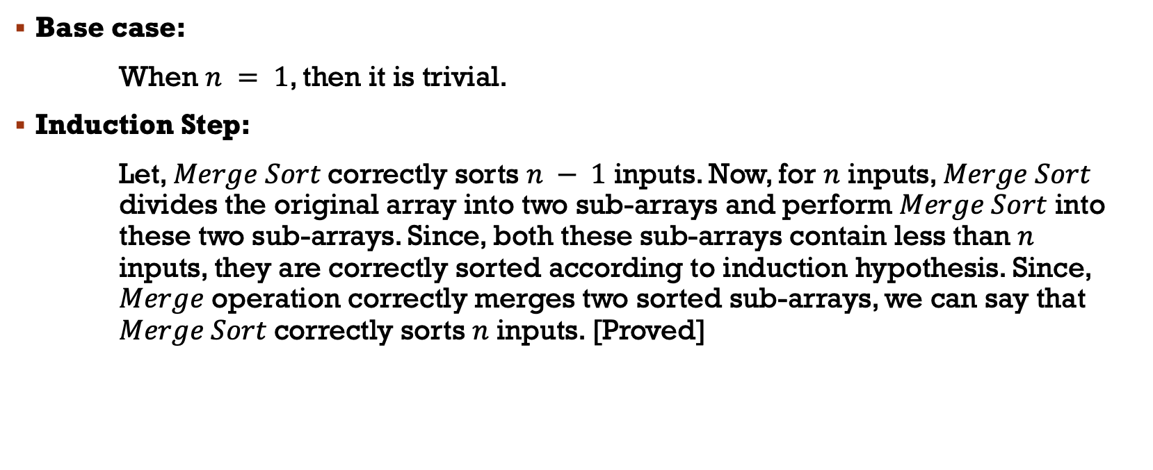
Correctness of Merge Sort Algorithm
Base case:
When $n = 1$, then it is trivial.
Induction Step:
Let, $Merge Sort$correctly sorts $n − 1$ inputs. Now, for $n$ inputs, $Merge Sort$ divides the original array into two sub-arrays and perform $Merge Sort$ into these two sub-arrays. Since, both these sub-arrays contain less than $n$ inputs, they are correctly sorted according to induction hypothesis. Since, $Merge$ operation correctly merges two sorted sub-arrays, we can say that $Merge Sort$correctly sorts $n$ inputs. [Proved]

Slide 30
Quick sort algorithm
Divide step is complex
find a pivot element and partition the array into three parts:
left part contains all elements smaller than pivot
the pivot itself, and
right part containing all elements larger than pivot.
Recursively perform quicksort on the left and right part

Slide 31
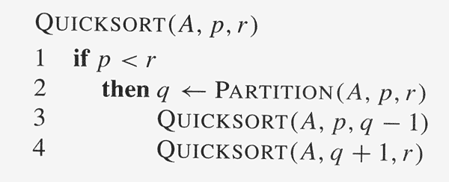
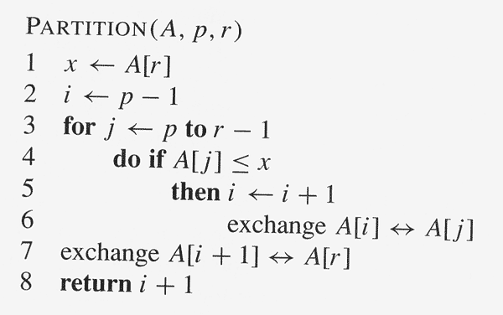
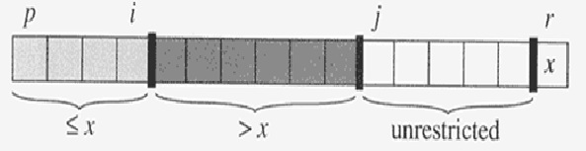
Quick sort algorithm

Slide 32



Quick sort algorithm
Array $A$
$$p$$
$$r$$
2
8
7
1
3
5
6
4

Slide 33

Quick sort algorithm
Array $A$
$$p$$
$$r$$
2
8
7
1
3
5
6
4
Pivot, $x = 4$

Slide 34

Quick sort algorithm
Array $A$
$$p$$
$$r$$
2
8
7
1
3
5
6
4
$$i$$
Pivot, $x = 4$

Slide 35

Quick sort algorithm
Array $A$
$$p$$
$$r$$
2
8
7
1
3
5
6
4
$$i$$
$$j$$
Pivot, $x = 4$

Slide 36

Quick sort algorithm
Array $A$
$$p$$
$$r$$
2
8
7
1
3
5
6
4
$$i$$
$$j$$
Pivot, $x = 4$
$$2 <= 4$$

Slide 37

Quick sort algorithm
Array $A$
$$p$$
$$r$$
2
8
7
1
3
5
6
4
$$i$$
$$j$$
Pivot, $x = 4$
$$2 <= 4$$

Slide 38

Quick sort algorithm
Array $A$
$$p$$
$$r$$
2
8
7
1
3
5
6
4
$$i$$
$$j$$
Pivot, $x = 4$
$$2 <= 4$$
exchange $2$ with $2$

Slide 39


Quick sort algorithm
Array $A$
$$p$$
$$r$$
2
8
7
1
3
5
6
4
$$i$$
$$j$$
Pivot, $x = 4$

Slide 40

Quick sort algorithm
Array $A$
$$p$$
$$r$$
2
8
7
1
3
5
6
4
$$i$$
$$j$$
Pivot, $x = 4$
$$8 <= 4$$

Slide 41

Quick sort algorithm
Array $A$
$$p$$
$$r$$
2
8
7
1
3
5
6
4
$$i$$
$$j$$
Pivot, $x = 4$
$$7 <= 4$$

Slide 42


Quick sort algorithm
Array $A$
$$p$$
$$r$$
2
8
7
1
3
5
6
4
$$i$$
$$j$$
Pivot, $x = 4$
$$1 <= 4$$

Slide 43
Quick sort algorithm
Array $A$
$$p$$
$$r$$
2
8
7
1
3
5
6
4
$$i$$
$$j$$
Pivot, $x = 4$
$$1 <= 4$$

Slide 44

Quick sort algorithm
Array $A$
$$p$$
$$r$$
2
8
7
1
3
5
6
4
$$i$$
$$j$$
Pivot, $x = 4$
$$1 <= 4$$
exchange $8$ with $1$

Slide 45

Quick sort algorithm
Array $A$
$$p$$
$$r$$
2
1
7
8
3
5
6
4
$$i$$
$$j$$
Pivot, $x = 4$
$$1 <= 4$$
exchange $1$ with $8$

Slide 46

Quick sort algorithm
Array $A$
$$p$$
$$r$$
2
1
7
8
3
5
6
4
$$i$$
$$j$$
Pivot, $x = 4$
$$3 <= 4$$

Slide 47
Quick sort algorithm
Array $A$
$$p$$
$$r$$
2
1
7
8
3
5
6
4
$$i$$
$$j$$
Pivot, $x = 4$
$$3 <= 4$$

Slide 48

Quick sort algorithm
Array $A$
$$p$$
$$r$$
2
1
7
8
3
5
6
4
$$i$$
$$j$$
Pivot, $x = 4$
$$3 <= 4$$
exchange $7$ with $3$

Slide 49
Quick sort algorithm
Array $A$
$$p$$
$$r$$
2
1
3
8
7
5
6
4
$$i$$
$$j$$
Pivot, $x = 4$
$$3 <= 4$$
exchange $7$ with $3$

Slide 50

Quick sort algorithm
Array $A$
$$p$$
$$r$$
2
1
3
8
7
5
6
4
$$i$$
$$j$$
Pivot, $x = 4$
$$5 <= 4$$

Slide 51


Quick sort algorithm
Array $A$
$$p$$
$$r$$
2
1
3
8
7
5
6
4
$$i$$
$$j$$
Pivot, $x = 4$
$$6 <= 4$$

Slide 52
Quick sort algorithm
Array $A$
$$p$$
$$r$$
2
1
3
8
7
5
6
4
$$i$$
Pivot, $x = 4$

Slide 53

Quick sort algorithm
Array $A$
$$p$$
$$r$$
2
1
3
8
7
5
6
4
$$i$$
Pivot, $x = 4$
exchange $8$ with $4$(pivot)

Slide 54
Quick sort algorithm
Array $A$
$$p$$
$$r$$
2
1
3
8
7
5
6
4
$$i$$
Pivot, $x = 4$
exchange $8$ with $4$(pivot)

Slide 55
Quick sort algorithm
Array $A$
$$p$$
$$r$$
2
1
3
4
7
5
6
8
$$i$$
Pivot, $x = 4$
exchange $8$ with $4$(pivot)

Slide 56
Quick sort algorithm
Array $A$
sorted
$$p$$
$$r$$
2
1
3
4
7
5
6
8
$$i$$
sort left part
<= 4
sort right part
>=4

Slide 57
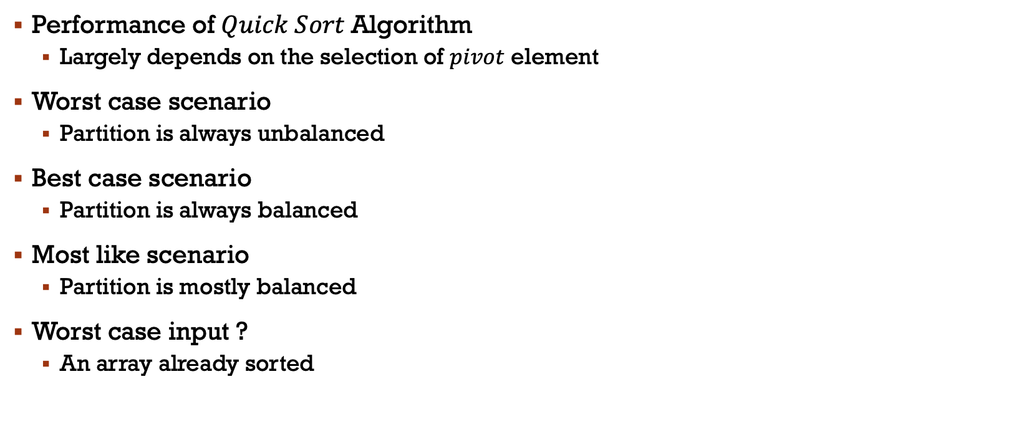
Quick sort algorithm: analysis
Performance of $Quick Sort$Algorithm
Largely depends on the selection of $pivot$ element
Worst case scenario
Partition is always unbalanced
Best case scenario
Partition is always balanced
Most like scenario
Partition is mostly balanced
Worst case input ?
An array already sorted

Slide 58









Quick Sort: Worst Case Partitioning
One sub-problem with $n−1$ elements
Another sub-problem with $0$ elements
Such unbalanced partition arises at every recursive call
$$O\left(1\right)$$
$$if n=1$$
$$T\left(n\right)=$$
$$T\left(n−1\right)$$
$+ T\left(0\right)$ +
$$O\left(1\right) +$$
$$otherise$$
$$O$$
solve left half
solve right half
dividing
merging

Slide 59




Quick Sort: Worst Case Partitioning
One sub-problem with $n−1$ elements
Another sub-problem with $0$ elements
Such unbalanced partition arises at every recursive call
$$b$$
$$if n=1$$
$$T\left(n\right)=$$
$$T\left(n−1\right)$$
$$+ bn$$
$$otherise$$
solve left half
Dividing + merging

Slide 60


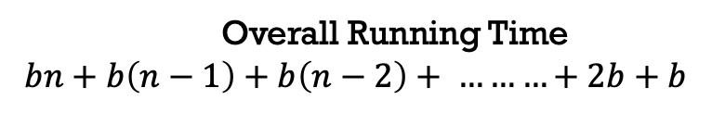





Quick Sort: Worst Case Partitioning
$bn$
$$0$$
$$b(n−1)$$
$$0$$
$$b(n−2)$$
Overall Running Time
$$bn+b\left(n−1\right)+b\left(n−2\right)+ ………+2b+b$$
$$0$$
$$2b$$
$$0$$
$$b$$

Slide 61
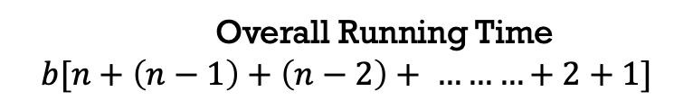
Quick Sort: Worst Case Partitioning
$bn$
$$0$$
$$b(n−1)$$
$$0$$
$$b(n−2)$$
Overall Running Time
$$b[n+\left(n−1\right)+\left(n−2\right)+ ………+2+1]$$
$$0$$
$$2b$$
$$0$$
$$b$$

Slide 62

Quick Sort: Worst Case Partitioning
$bn$
$$0$$
$$b(n−1)$$
$$0$$
$$b(n−2)$$
Overall Running Time
$$b[\frac{n (n+1)}{2} ]$$
$$0$$
$$2b$$
$$0$$
$$b$$

Slide 63

Quick Sort: Worst Case Partitioning
$bn$
$$0$$
$$b(n−1)$$
$$0$$
$$b(n−2)$$
Overall Running Time
$$b[\frac{n^{2}+n}{2} ]$$
$$0$$
$$2b$$
$$0$$
$$b$$

Slide 64

Quick Sort: Worst Case Partitioning
$bn$
$$0$$
$$b(n−1)$$
$$0$$
$$b(n−2)$$
Overall Running Time
$O(n^{2})$
$$0$$
$$2b$$
$$0$$
$$b$$

Slide 65



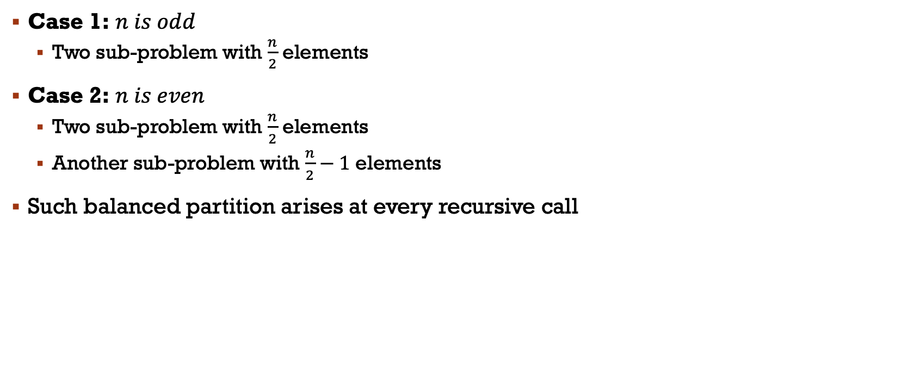





Quick Sort: Best Case Partitioning
Case 1: $n is odd$
Two sub-problem with $\frac{n}{2}$ elements
Case 2: $n is even$
Two sub-problem with $\frac{n}{2}$ elements
Another sub-problem with $\frac{n}{2}−1$ elements
Such balanced partition arises at every recursive call
$$O\left(1\right)$$
$$if n=1$$
$$T\left(n\right)=$$
$$T\left(n/2\right)$$
$+ T\left(n/2\right)$ +
$$O\left(1\right) +$$
$$otherise$$
$$O$$
solve left half
solve right half
dividing
merging

Slide 66



Quick Sort: Best Case Partitioning
Case 1: $n is odd$
Two sub-problem with $\frac{n}{2}$ elements
Case 2: $n is even$
Two sub-problem with $\frac{n}{2}$ elements
Another sub-problem with $\frac{n}{2}−1$ elements
Such balanced partition arises at every recursive call
$$b$$
$$if n=1$$
$$T\left(n\right)=$$
$$T\left(n/2\right)$$
$+ T\left(n/2\right)$ +
$$bn$$
$$otherise$$
solve left half
solve right half
Dividing + merging

Slide 67
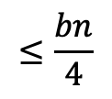
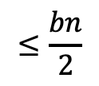
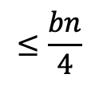



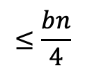

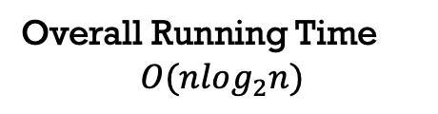
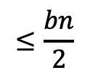

Quick Sort: Best Case Partitioning
$$bn$$
$bn$
$$≤\frac{bn}{2}$$
$$≤\frac{bn}{2}$$
$$≤bn$$
$$\log_{2}{n}$$
Overall Running Time
$$O(nlog_{2}n)$$
$$≤\frac{bn}{4}$$
$$≤\frac{bn}{4}$$
$$≤\frac{bn}{4}$$
$$≤\frac{bn}{4}$$
$$≤bn$$
$$b$$
$$b$$
$$b$$
$$b$$
$$b$$
$$b$$
$$b$$
$$bn$$

Slide 68








Quick Sort: Average Case Partitioning
Assume that the input is random, the average-case running time is much closer to $O(nlog_{2}n)$ than $O(n^{2})$
Intuitive example
Suppose that the partitioning algorithm always produces a $9−to−1$ proportional split
$$O\left(1\right)$$
$$if n=1$$
$$T\left(n\right)=$$
$$T\left(n/10\right)$$
$+ T\left(9n/10\right) +$
$$O\left(1\right) +$$
$$otherise$$
$$O$$
solve left half
solve right half
dividing
merging

Slide 69



Quick Sort: Average Case Partitioning
Assume that the input is random, the average-case running time is much closer to $O(nlog_{2}n)$ than $O(n^{2})$
Intuitive example
Suppose that the partitioning algorithm always produces a $9−to−1$ proportional split
$$b$$
$$if n=1$$
$$T\left(n\right)=$$
$$T\left(n/10\right)$$
$+ T\left(9n/10\right) +$
$$bn$$
$$otherise$$
solve left half
solve right half
Dividing + merging

Slide 70
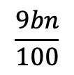
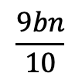





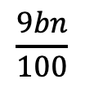
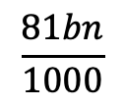
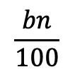
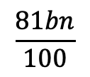
Quick Sort: Average Case Partitioning
$$bn$$
$$\frac{bn}{10}$$
$$\frac{9bn}{10}$$
$$\frac{bn}{100}$$
$$\frac{9bn}{100}$$
$$\frac{9bn}{100}$$
$$\frac{81bn}{100}$$
$$b$$
$$\frac{81bn}{1000}$$
$$\frac{729bn}{1000}$$
$$b$$

Slide 71




Quick Sort: Average Case Partitioning
$$bn$$
$$bn$$
$$\frac{bn}{10}$$
$$\frac{9bn}{10}$$
$$bn$$
$$\frac{bn}{100}$$
$$\frac{9bn}{100}$$
$$\frac{9bn}{100}$$
$$\frac{81bn}{100}$$
$$bn$$
$$b$$
$$\frac{81bn}{1000}$$
$$\frac{729bn}{1000}$$
$$bn$$
$$≤bn$$
$$b$$
$$≤bn$$

Slide 72


Quick Sort: Average Case Partitioning
$$bn$$
$$bn$$
$$\frac{bn}{10}$$
$$\frac{9bn}{10}$$
$$bn$$
$$\log_{10}{n}$$
$$\frac{bn}{100}$$
$$\frac{9bn}{100}$$
$$\frac{9bn}{100}$$
$$\frac{81bn}{100}$$
$$\log_{10/9}{n}$$
$$bn$$
$$b$$
$$\frac{81bn}{1000}$$
$$\frac{729bn}{1000}$$
$$bn$$
$$≤bn$$
$$b$$
$$≤bn$$

Slide 73

Quick Sort: Average Case Partitioning
Intuitively, a real-life run of quicksort is a mix of “bad” and “good” partitions
They will distribute randomly over the recursion tree
Difference between
Splitting the root node to produce a$“good”$partitions
Splitting the root node to produce a $“bad”$partitions → then split the $(n−1)$sized node to produce $“good”$partitions

Slide 74






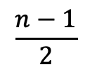
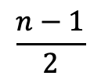
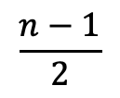
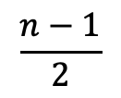
Quick Sort: Average Case Partitioning
Intuitively, a real-life run of quicksort is a mix of “bad” and “good” partitions
They will distribute randomly over the recursion tree
Difference between
Splitting the root node to produce a$“good”$partitions
Splitting the root node to produce a $“bad”$partitions → then split the $(n−1)$sized node to produce $“good”$partitions
$$n$$
$$n$$
$$Θ(n)$$
$$n$$
$$Θ(n)$$
$$\frac{n−1}{2}$$
$$\frac{n−1}{2}$$
$$0$$
$$n−1$$
$$\frac{n−1}{2}$$
$$\frac{n−1}{2}$$

Slide 75
Content Courtesy
Dr. Abul Kashem Mia, Professor, CSE, BUET
Sukarna Barua, Assistant Professor, CSE, BUET

